Slide 1
42nd Meeting of the US / Canada Hydrographic Commission (USCHC) Biloxi, Mississippi, USA, March 2019 IHO Secretariat Report Dr Mathias Jonas Secretary-General

Slide 2
Oral report of the IHO Secretariat along the IHO Work Programme
Corporate Affairs
Hydrographic Standards and Services
Inter Regional Cooperation and Support
IHO Secretariats operations
Notes:
Missing MS: Kambodsha, Timor Leste, Marshall Islands, Micronesia and Palau

Slide 3
1. Corporate Affairs
Follow up of the 2nd IHO Council
Support of UN Decade of the Ocean Science for Sustainable Development;
Sponsorship of Seabed2030;
Notes:
Three months before an ordinary session of the Assembly, the Secretary-General shall inform the Chair of the RHC of: a. the number of seats allocated to the RHC, and b. those Member States that are eligible for selection by the RHC.
MY and ID will occupy seats allocated to EAHC.
D2 – CN, SG, ROK and JP will occupy a seat based on tonnage.
IOC revised MOU:

Slide 4
Corporate Affairs / 2nd IHO Council Highlights
S-100 Implementation Plan
Crowd Source Bathymetry Guidance + positive list
Strategic Plan Review
New digital presence of the Organization

Slide 5
Corporate Affairs / UN Decade of the Ocean Science (1)
Promote UN-GGIM Statement of shared guiding principles for geospatial information management, highlighting the use of standards and interoperability for hydrographic data.
Continued support of GGIM´s Working Group on Marine Geospatial Information.
Contribution to the 1st World Geospational Information Congress (UNWGIC) in Deqing, Zhejiang Province, China.

Slide 6
Corporate Affairs / UN Decade of the Ocean Science (2)
Update of MoU with the Intergovernmental Oceanographic Commission (IOC) of UNESCO:
Promote national and regional MSDI.
Support IOC´s vision of an atlas of the oceans through application of the S-100 framework for oceanographic information such as chemistry, biology etc.
Include reference to IHO’s and IOC´s GIS services.
Strengthen cooperation in the development and maintenance of e-learning training as part of capacity building.

Slide 7
Corporate Affairs / Seabed2030
IHO and IOC are acknowledged sponsors of the project (not in fiscal terms). Regular sponsors meeting of all parties involved.
Clear task sharing between GEBCO project and Seabed2030.
Recruitment of a new project director is well underway.
Notes:
GEBCO: contributions from governmental bodies – federal survey, ocean science campaigns, CSB
SB2030: commercial survey, powerhouse for new technology JEMSTEC, X-Prize

Slide 8
2. Hydrographic Standards and Services
IMO Criticism on ECDIS performance in the field
Progress within the S-100 framework
Nautical Information Provision Working Group (NIPWG) update
Data Quality Maintenance Working Group (DQMWG) update

Slide 9
HSSC / recent IMO comments on ECDIS
At the IMO-NCSR6 the UK Marine Accident Investigation Branch (MAIB) and the Danish Maritime Accident Investigation Board (DMAIB) presented a safety study into use ECDIS on board ships. The investigators had embarked on 29 ECDIS-fitted vessels of various types: dredgers, buoy layers, general cargo ships, container ships, tankers and cruise ships.
Compilation of views of the interviewed deck officers in consideration of future ECDIS improvements:
fewer alarms;
bigger screens and more touch-screen and tablet technology;
simpler systems (less complex menu structures);
standardized interfaces such as keyboards;
more integration (radar/digital publications/NAVTEX);
increased contour density;
the display of height of tide data;
the display of MARPOL limits;
better font/symbol size and colour;
better palettes/contrast in all time of day modes; and
faster internet.

Slide 10
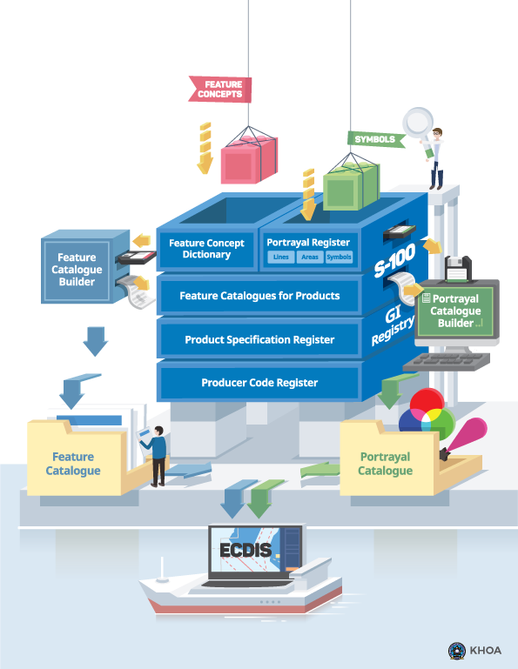
HSSC / S-100 Progress / S-100 Edition 4.0.0 approved

Slide 11
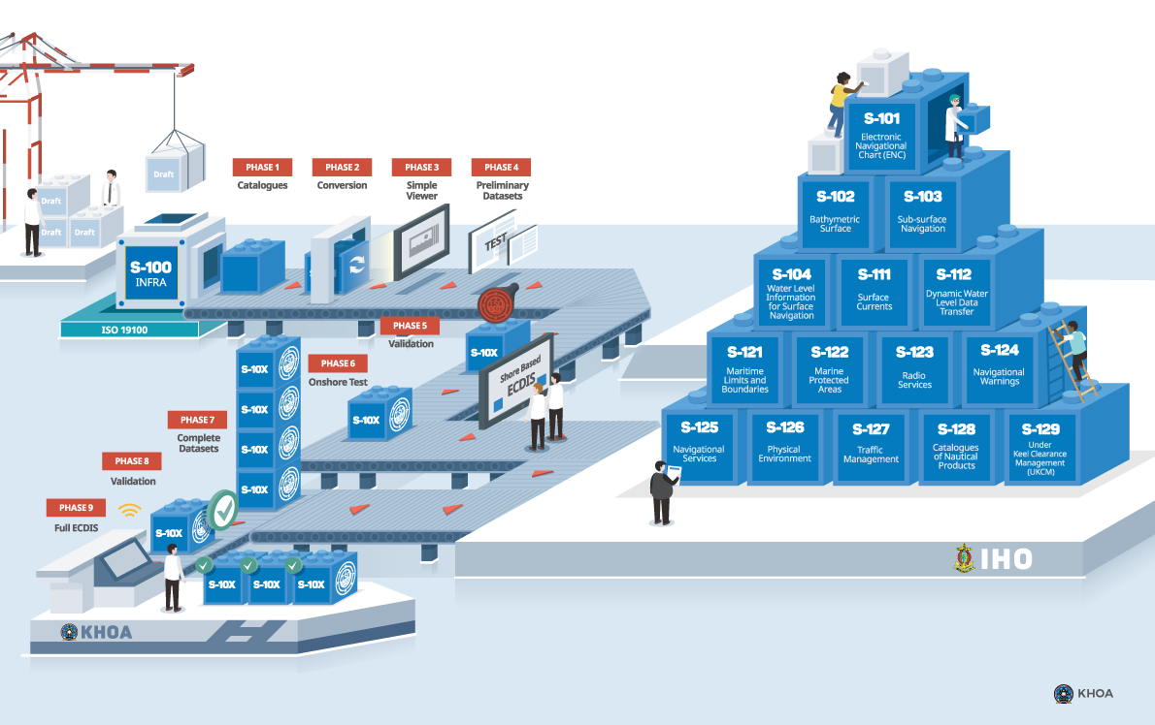
Product Specifications of IHO (Numbers S-101 to 199)
S-101 | Electronic Navigational Chart (ENC)
S-102 | Bathymetric Surface
S-103 | Sub-surface Navigation
S-104 | Tidal Information for Surface Navigation
S-111 | Surface Currents
S-112 | Dynamic Water Level Data
S-121 | Maritime Limits and Boundaries
S-122 | Marine Protected Areas
S-123 | Radio Services
S-124 | Navigational Warnings
S-125 | Navigational Services
S-126 | Physical Environment
S-127 | Traffic Management
S-128 | Catalogues of Nautical Products
S-129 | Under Keel Clearance Management
Product Specifications of International Association of Marine Aids to Navigation and Lighthouse Authorities (IALA) (Numbers S-201 to 299)
S-201 | Aid to Navigation Information
S-210 | Inter-VTS Exchange Format
S-230 | Application Specific Messages
S-240 | DGNSS Station Almanach
S-245 | eLoran ASF Data
S-246 | eLoran Station Almanac
Product Specifications of Intergovernmental Oceanographic Commission (IOC) (Numbers S-301 to 399)
 | unfortunately still empty
Product Specifications of other Organizations (Numbers from S-401)
S-401 | Inland ENC (Inland ENC Harmonization Group)
S-411 | Ice Information (Joint Technical Commission for Oceanography and Marine Meteorology)
S-412 | Weather Overlay (JCOMM)
HSSC / S-100 Progress / S-100 GI Registry renewed

Slide 12
HSSC / S-100 Progress
First versions of S-101 (Next Generation ENC) and S-111 Surface Currents are now out for comments;
S-101 Edition 2.0.0 is scheduled to be released by the end of 2020 and can be used for sea-trials. Edition 3.0.0 is scheduled to be released by the end of 2022 for full production use.
S-122 (Marine Protected Areas) and S-123 (Radio Services) approved.

Slide 13
HSSC / NIPWG update – compelling need for harmonization
General purpose
Transfer mode
Specific usage
Update mechanism
Spatial representation
S-126 MPE
S-122 MPA
S-123 MRS
S-128 CTLG
S-127 MTM
13

Slide 14
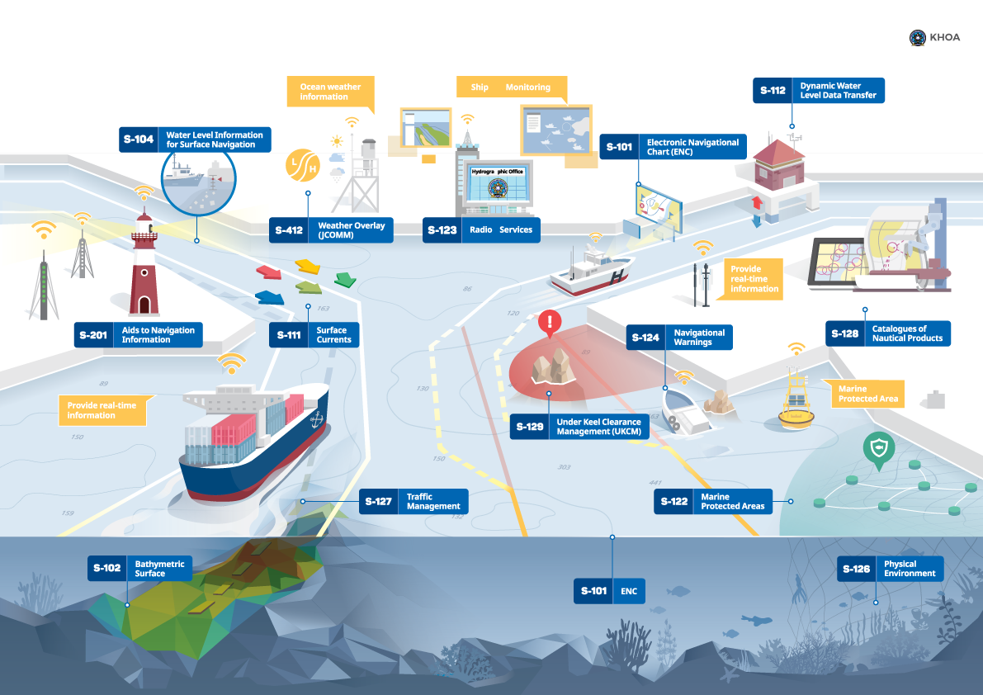
HSSC / S-100 Progress
We need:
Commitment for regular Production of datasets;
Regional test beds!

Slide 15
HSSC / DQMWG update (1) – MASS needs quality of data
IMO MASS - Maritime Autonomous Surface Ships – is on the horizon!
Harmonization of data quality indicators for bathy data, describing to allocate S-44 values for different types of survey techniques and move to CATZOC values.
Outcome: Guidance on quality aspects to allocate meaningful quality values of bathymetric data in future S-101 ENC. Description of a the convertor of S-57 (CATZOC) to S-101 (QoBD).
Notes:
Crowd Source Bathymetry Data is assigned CATZOC = D.
Satellite Derived Bathymetry is assigned CATZOC = C.
LIDAR data is assigned CATZOC = B, one member sometimes assigns CATZOC = A2.
Surveys from ports are usually assigned CATZOC = B, some port authorities assign CATZOC = A1, to be evaluated by the HO on a port-by-port basis.
Some members do not downgrade CATZOC over time due to temporal variation but provide M_SREL data.

Slide 16
HSSC / DQMWG update (2) – quality of data makes ECDIS better
Data Quality Checklist for Product Specifications to become the Part C of the IHO Publication S-97 – IHO Guidelines for Creating S-100 Product Specifications.
During an interactive workshop, the meeting considered methodologies for the display of quality information (ongoing since years).
While noting the obstacles to of an evolution of IMO’s ECDIS standards in the short term, several findings were identified that will help to define a new portrayal concept. When finalized, it will be submitted to the other HSSC Working Groups for testing, and possible implementation in the design of future S-101 ECDIS.

Slide 17
3. Inter Regional Coordination and Support
ENC coverage and overlap update
GEBCO project update
Crowd Sourced Bathymetry update
Iridium as new Marine Safety Information provider

Slide 18
IRCC / ENC coverage and overlap update (1)
IC-ENC’s Overlapping Data Reporting and Analysis (WENDWG9 WP)

Slide 19
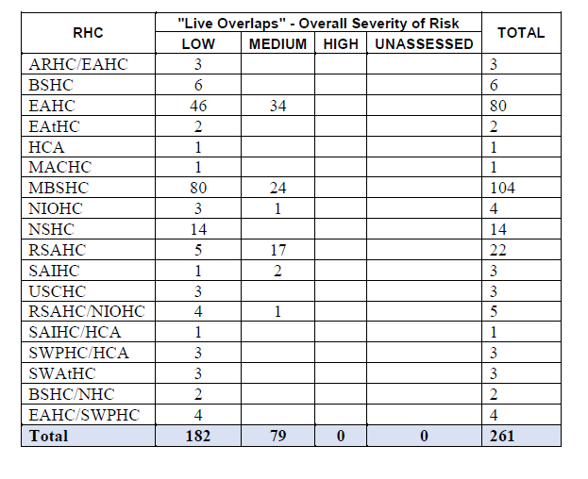
IRCC / ENC overlap update for IC-ENC members (2)
A detailed overlap report was delivered to USCHC by
IC-ENC in September 2018

Slide 20
IRCC / GEBCO Project update
IHO Data Center for Digital Bathymetry (DCDB) released new data viewer.
DCDB releases new global grid of 15 Arc resolution – four times higher resolution as before!
DCDB negotiates with numerous new CSB providers to interface to their data collections.

Slide 21
IRCC / Crowd Source Bathymetry
B-12 Guidance on Crowd source bathymetry is out for voting (IHO CL11 refers).
IHO CL11 comes with a separate template to seek for national acceptance of CSB in national waters of jurisdiction.
Target date for approval of B-12 Guidance on Crowd source bathymetry Edition 2.0.0 is 5th April 2019.
Target date for reply of national position on CSB in waters of national jurisdiction is 20th May 2019.

Slide 22
IRCC / Iridium as new MSI provider (1)
Maritime Mobile Satellite Services provided by Iridium Satellite LLC are now recognized for use in GMDSS.
Draft interim preliminary text of a WWNWS system service manual be presented to MSC 101 for wider publication to allow Initial Operational Certificates (IOC) to be issued to selected NAV and MET Area Coordinators and RCCs, which will enable operational testing of the system and services.
It is proposed that an expanding number of certificates will be issues throughout 2019 so that Full Operational Certificates (FOC) can be issued around the end of 2019.
The necessary SOLAS amendments are planned to come into force on 1 January 2020, after which Iridium can commence full operational service.
USCHC Action: Take note of the anticipated rearrangements and prepare information for affected shipping industry.

Slide 23
IRCC / Iridium as new MSI provider (2)
All NAV and MET Area Coordinators and RCCs will be required to provide MSI and SAR services via all recognized mobile satellite service providers, i.e. Inmarsat and Iridium.
To meet their SOLAS requirements, ships will be required to carry either a type approved Inmarsat or Iridium receiver, they can of course carry one of each to meet the spare backup requirement.
All information providers will be required to transmit their messages via both Inmarsat and Iridium, and in the future via all other IMO appropriate recognized mobile satellite service providers, global or regional coverage, such as BeiDou and the UAE based Thuraya satellite system, which has applied for recognition for the Gulf region.
Note at present, unlike GNSS, there are no multi-system capable ship receivers available.
USCHC Action: Take note of the anticipated rearrangements and prepare information for affected shipping industry.

Slide 24
4. IHO Secretariats operations
Renewal of INToGIS Service interface
Online voting for CLs
Ongoing activities on a technical overhaul of IHO Secretariat´s communication channels
Social media
Corporate Design
Website
Preparations for IHO Centenary celebrations

Slide 25
Secretariats operations / INToGIS II

Slide 26
(for CL response, C-55 and P-5)
Secretariats operations / online voting (1)
Member States will be able to submit their information directly from IHO Online form system. It will be soon announced with its password to enter.
It will be used for CL voting and IHO publications C-55 and P-5 (Yearbook) updating.
Data providers are requested to put two email addresses (one: personal, the other: official HO address listed in P-5) They will receive a PDF receipt message when data is submitted.
The traditional submission (postal letter, fax, email) is also available.

Slide 27
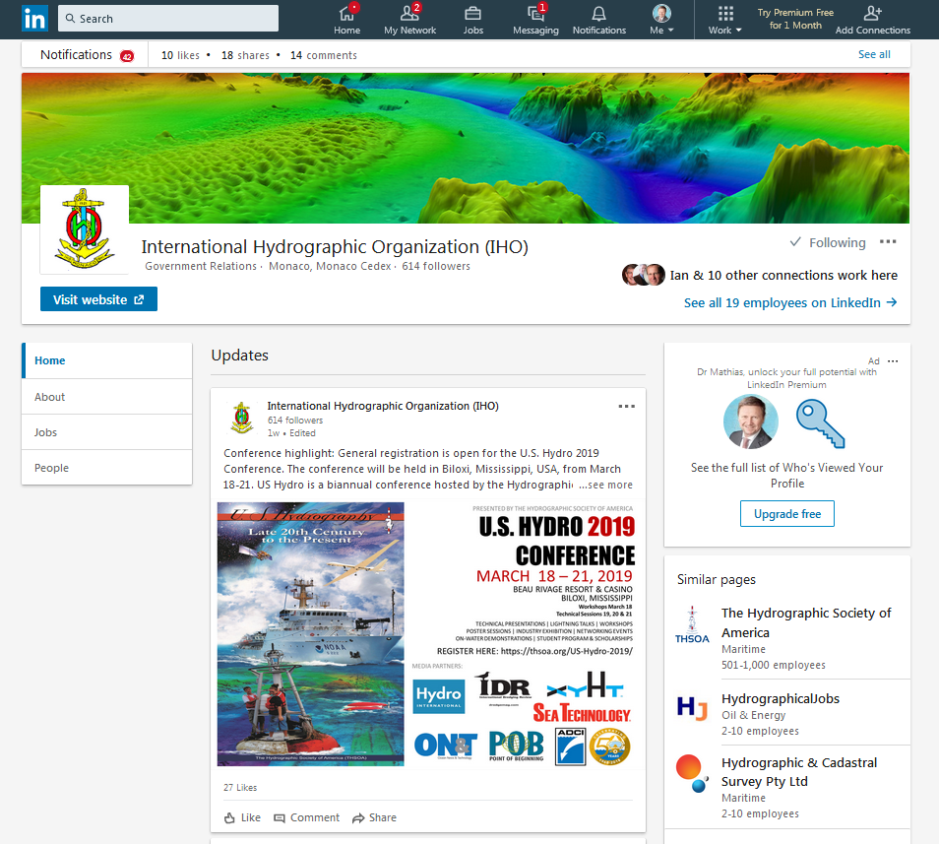
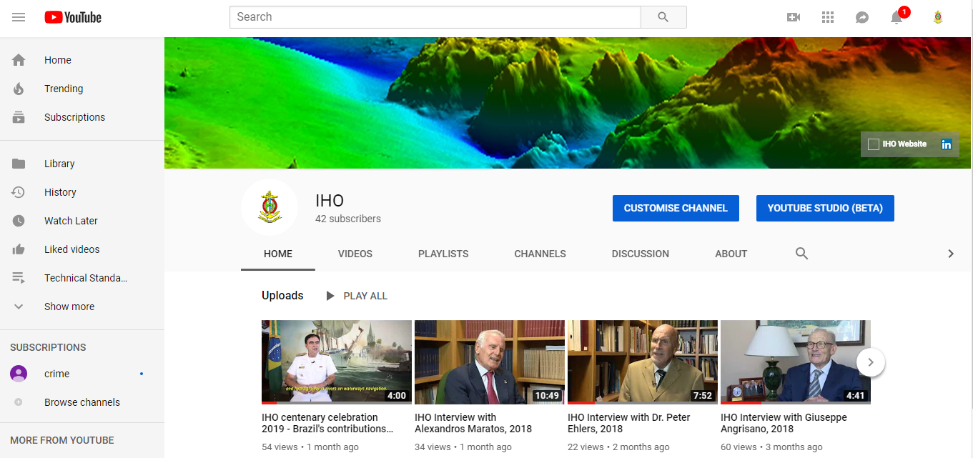
Secretariats operations / social media
Thanks to US remote secondment, the Secretariat is now active under LinkedIn and youtube.

Slide 28
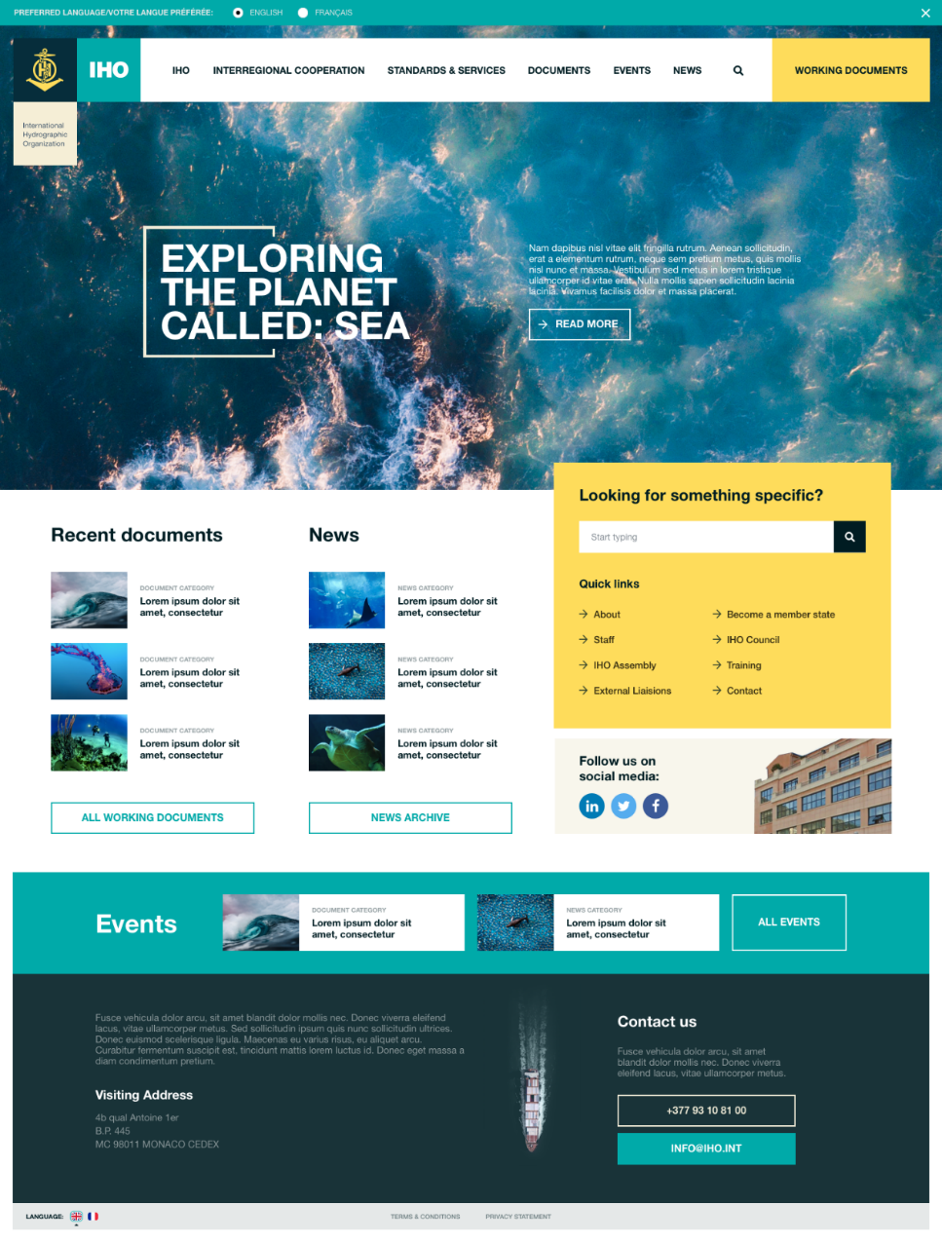
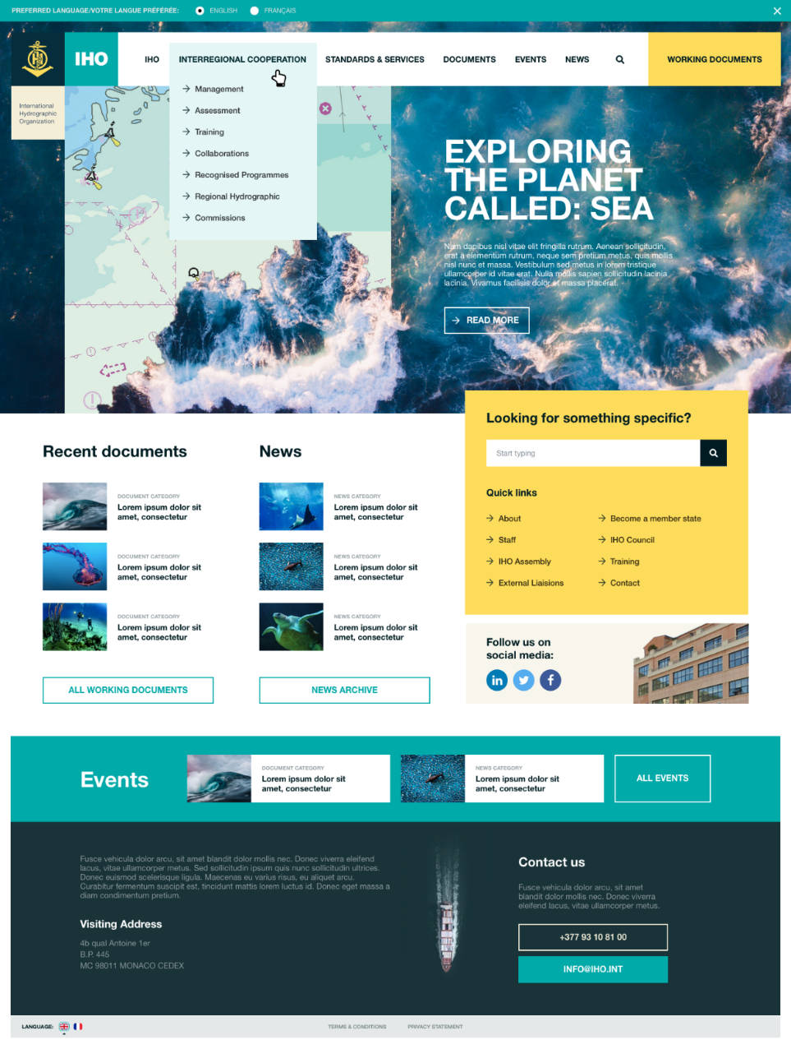
Secretariats operations / IHO website: new creative design homepage

Slide 29
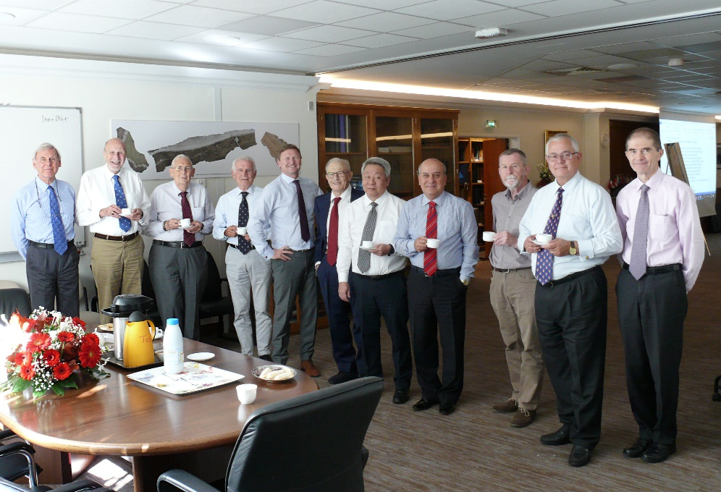
Secretariats operations / IHO 100 years (1)
IHO Prestige book project: “100 years of international cooperation in hydrography”
Illustrate in an educational and entertaining manner the importance and variety of the activities, outputs and developments of the IHO and its effective role in supporting maritime activities: History, Present and Future!
Group of Co-Authors led by Editor in Chief: Gilles Bessero
Chris Andreasen
Mike Barritt
Hans-Werner Schenke / Shin Tani
Peter Ehlers
Hugo Gorziglia
Horst Hecht / Giuseppe Angrisano
Mathias Jonas
Alexandros Maratos
Parry Oei
Robert Ward
Shepard Smith

Slide 30
Secretariats operations / IHO 100 years (2)
Monaco, April 2019:
Historic Nautical Charting and the Mediterranean – Exhibition at Monaco Yacht Club
Monaco, 21rst June 2019:
Symposium “Historical Approach for Measurements and Protection of Oceans and World Waters’’ ” to be held at the Oceanographic Museum of Monaco
Monaco, April 2020:
Second IHO Assembly:
Special session about the history of the Organization
New approach for the chart exhibition – science on a sphere

Slide 31
Secretariats operations / IHO 100 years (3)
Monaco, 21rst June 2021:
Peak event back to back with IRCC annual meeting:
“100 years of international cooperation in hydrography”
Consider a submission to the UN General Assembly session of 2021:
Commitment of IHO to Sustainable Development Goals through improved provision of hydrographic knowledge (?)

Slide 32
Hydrographic information driving marine knowledge
USCHC is requested to take note of this report and take action as deemed appropriate.
Thank you for your audience and ongoing support of IHO.

